Slide 1
Differentiable optimization-based modeling for machine learning
Brandon Amos • Meta AI (FAIR)
Joint with Akshay Agrawal, Shane Barratt, Byron Boots, Stephen Boyd, Roberto Calandra, Steven Diamond, Priya Donti, Ivan Jimenez, Zico Kolter, Nathan Lambert, Jacob Sacks, Omry Yadan, and Denis Yarats

Slide 2
Can we throw big neural networks at every problem?
(Maybe) Neural networks are soaring in vision, RL, and language
A lot of data
Model
Predictions
Loss
AGI: A pile of linear algebra?

Slide 3
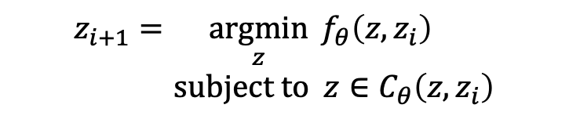
Optimization-based modeling for machine learning
A lot of data
Model
Predictions
Loss
…
Optimization Layer
…
$$z_{i+1}=\underset{z}{argmin}{f_{θ}\left(z, z_{i}\right)} \\ subject to z∈C_{θ}\left(z, z_{i}\right)$$
Adds domain knowledge and hard constraints to your modeling pipeline
Integrates and trains nicely with your other end-to-end modeling components
Applications in RL, control, meta-learning, game theory, optimal transport

Slide 4
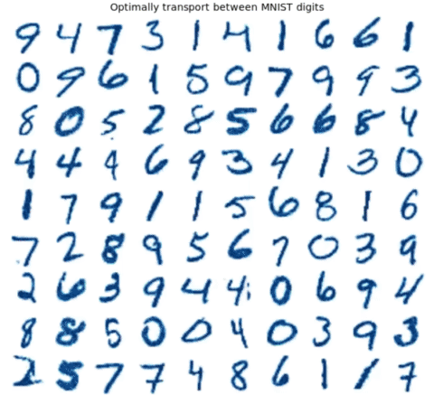
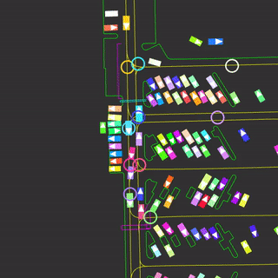
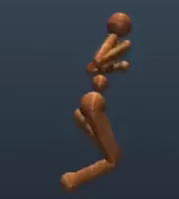
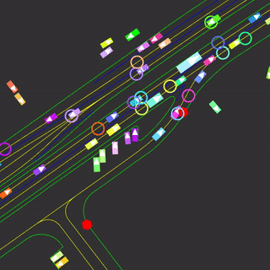
Why optimization-based modeling?
Non-trivial reasoning operations are fundamentally optimization problems
Why unnecessarily approximate them? (e.g. with a neural network)
Explicitly model the optimization components and learn the rest (when possible)

Slide 5


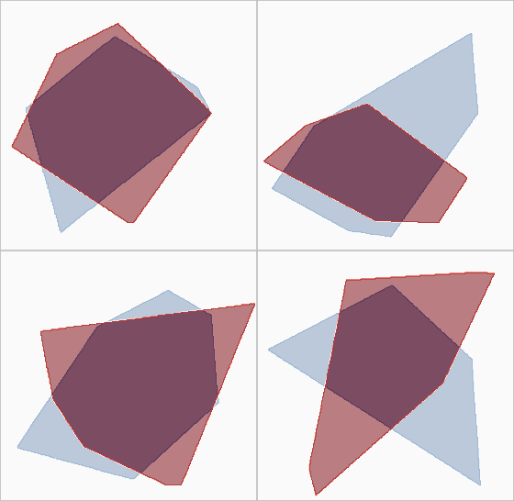
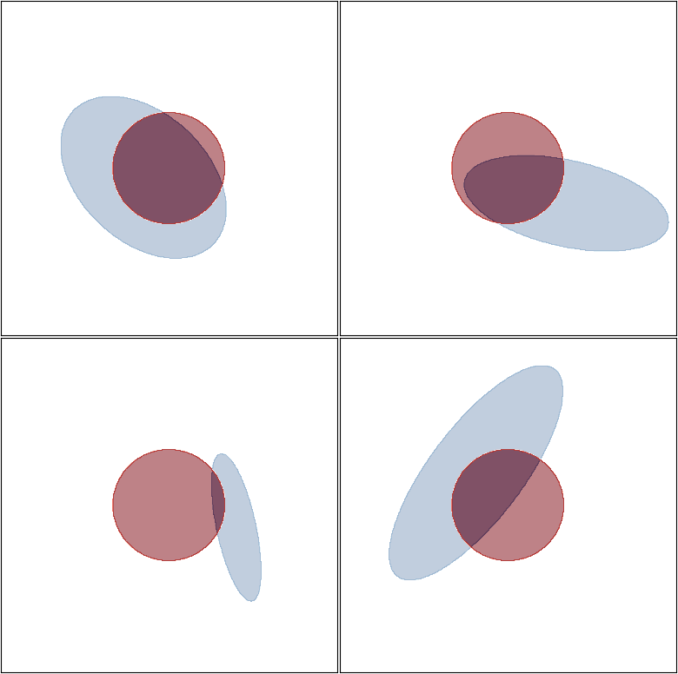
Optimization layers model hard constraints
True Constraint (Unknown to the model)
Constraint Predictions During Training
Example 1
Example 2
Example 1
Example 2
Example 3
Example 4
Example 3
Example 4

Slide 6
This talk: differentiable optimization-based models
Standard operations as convex optimization layers — warmup
Differentiable optimization theory and practice — core
Differentiable control and objective mismatch — focus application

Slide 7
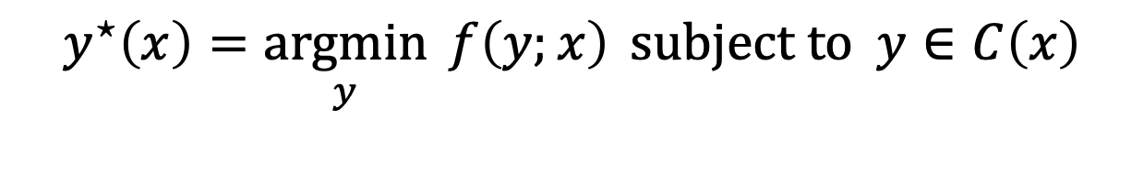
Convex optimization is expressive
The argmin of a convex optimization problem is non-convex and expressive
Standard non-linearities to be seen as solutions to convex optimization problems
We’ll start simple for intuition and motivation to generalize beyond these
$$y^{⋆}\left(x\right)=\underset{y}{argmin}{f\left(y;x\right)} subject to y∈C\left(x\right)$$

Slide 8
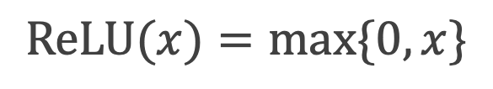
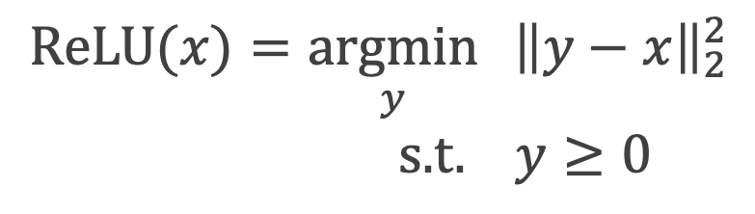
The ReLU is a convex optimization layer
Proof: Comes from first-order optimality (section 2 of my thesis)
$$\text{ReLU}(x)=\max{\{0, x\}}$$
$$\text{ReLU}(x)=\underset{y}{argmin}{ {\left\|y−x\right\|}_{2}^{2}} \\ \text{s}\text{.}\text{t}\text{. } y≥0$$

Slide 9
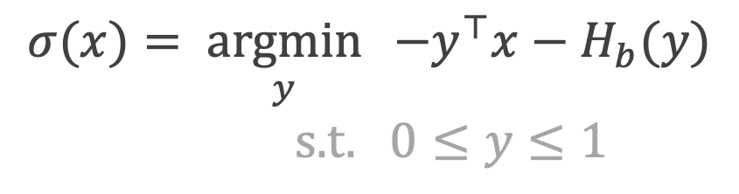
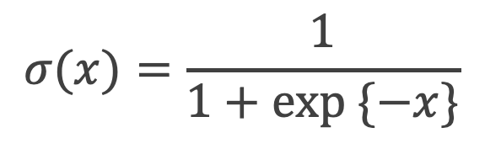
The sigmoid is a convex optimization layer
Proof: Comes from first-order optimality (section 2 of my thesis)
$$σ(x)=\frac{1}{1+exp \{−x\}}$$
$$σ(x)=\underset{y}{argmin}{ −y^{⊤}x−H_{b}(y)} \\ \text{s}\text{.}\text{t}\text{. }0≤y≤1$$

Slide 10
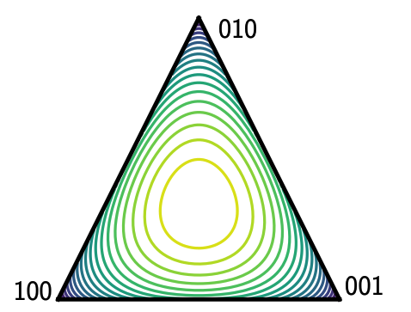
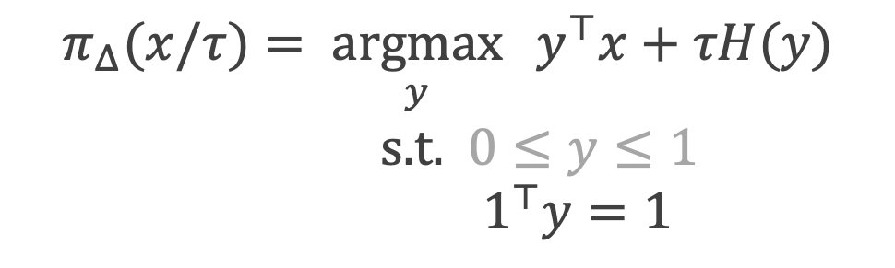
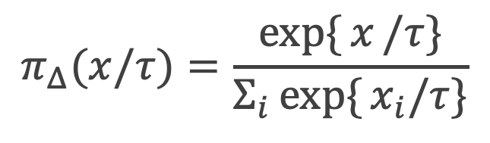
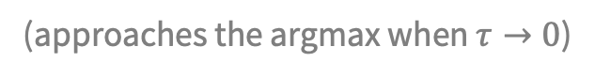
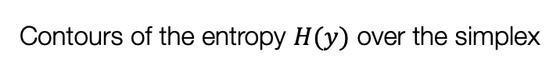
The soft-argmax is a convex optimization layer
Proof: Comes from first-order optimality (section 2 of my thesis)
$$π_{Δ}(x/τ)=\frac{exp⁡\{{x}/τ\}}{Σ_{i}exp\{{x_{i}/τ\}}}$$
$$π_{Δ}(x/τ)=\underset{y}{argmax}{ y^{⊤}x+τH(y)} \\ \text{s}\text{.}\text{t}\text{.} 0≤y≤1$$
$${ 1}^{⊤}y=1$$
Contours of the entropy $H(y)$ over the simplex
(approaches the argmax when $τ→0$)

Slide 11
How can we generalize this?
$$z_{i+1}\left(z_{i}\right)=\underset{z}{argmin}{f_{θ}\left(z, z_{i}\right)} subject to z∈C_{θ}\left(z, z_{i}\right)$$
Derivatives and backpropagation
For learning, we differentiate or backpropagate through these layers — differentiable optimization
Easy if the optimization problem has an explicit, closed-form solution (often standard differentiation)
Otherwise, need to use implicit differentiation, which is also used for sensitivity analysis

Slide 12
This talk: differentiable optimization-based models
Standard operations as convex optimization layers — warmup
Differentiable optimization theory and practice — core
Differentiable control and objective mismatch — focus application

Slide 13
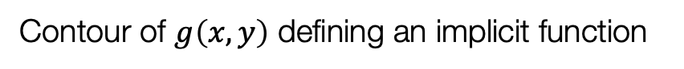
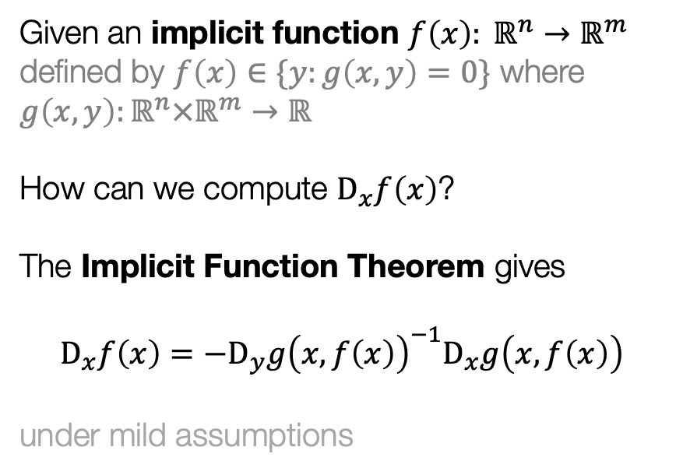
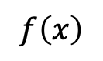


The Implicit Function Theorem
[Dini 1877, Dontchev and Rockafellar 2009]
Contour of $g\left(x, y\right)$ defining an implicit function
Given an implicit function $f\left(x\right): ℝ^{n}→ℝ^{m}$ defined by $f\left(x\right)∈\{y:g\left(x,y\right)=0\}$ where $g\left(x,y\right):ℝ^{n}×ℝ^{m}→ℝ$
How can we compute $D_{x}f\left(x\right)$?
The Implicit Function Theorem gives $$D_{x}f\left(x\right)=−D_{y}g{\left(x,f\left(x\right)\right)}^{−1}D_{x}g\left(x, f\left(x\right)\right)$$ under mild assumptions
$$f\left(x\right)$$
$$D_{x}g(x, f\left(x\right))$$
$$D_{y}g(x, f\left(x\right))$$

Slide 14
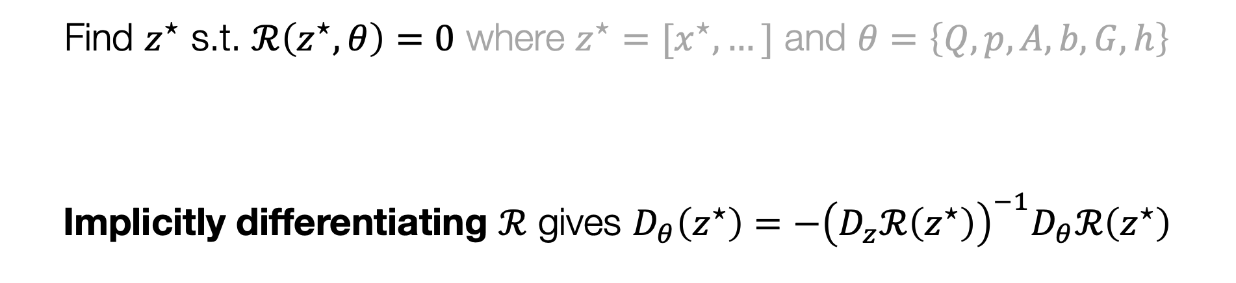
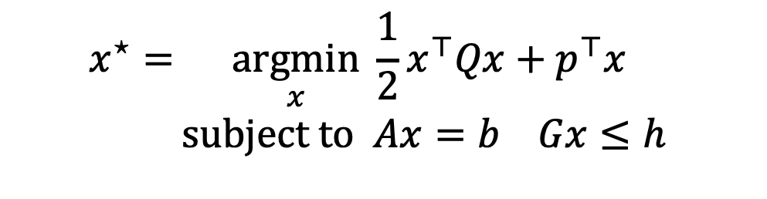
Implicitly differentiating a convex quadratic program
Original problem considered in OptNet
$$x^{⋆}=\underset{x}{argmin}{\frac{1}{2}x^{⊤}Qx+p^{⊤}x} \\ subject to Ax=b Gx≤h$$
KKT Optimality
Find $z^{⋆}$ s.t. $ℛ\left(z^{⋆}, θ\right)=0$ where $z^{⋆}=[x^{⋆},…]$ and $θ=\left\{Q,p,A,b,G,h\right\}$
Implicitly differentiating $ℛ$ gives $D_{θ}\left(z^{⋆}\right)=−{\left(D_{z}ℛ\left(z^{⋆}\right)\right)}^{−1}D_{θ}ℛ\left(z^{⋆}\right)$

Slide 15
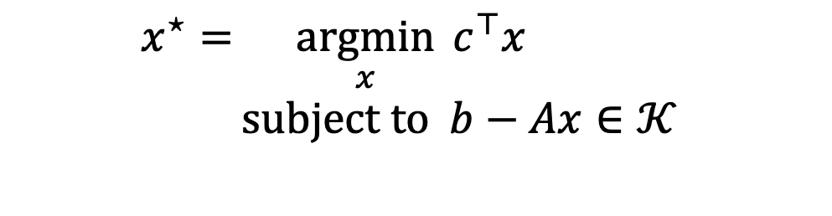
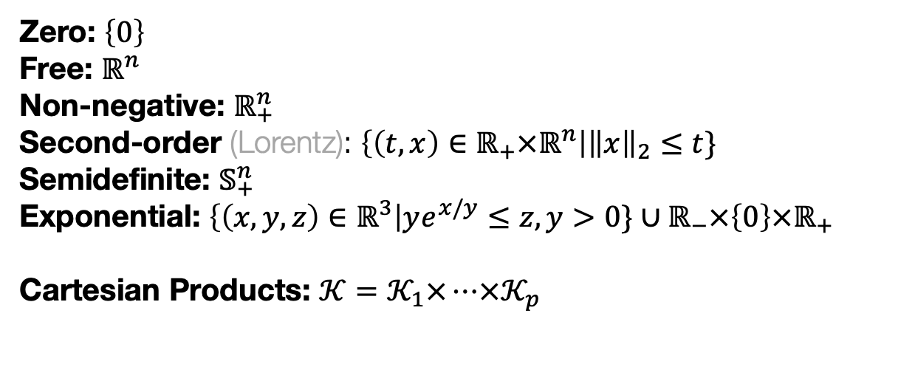
Background: cones and conic programs
Most convex optimization problems can be transformed into a (convex) conic program
$$x^{⋆}=\underset{x}{argmin}{c^{⊤}x} \\ subject to b−Ax∈𝒦$$
Zero: $\left\{0\right\}$ Free: $ℝ^{n}$ Non-negative: $ℝ_{+}^{n}$ Second-order (Lorentz): $\left\{\left(t,x\right)∈ℝ_{+}×ℝ^{n}\right|{\left\|x\right\|}_{2}≤t\}$ Semidefinite: $𝕊_{+}^{n}$ Exponential: $\left\{\left(x,y,z\right)∈ℝ^{3}\right|ye^{x/y}≤z, y>0\}∪ℝ_{−}×\left\{0\right\}×ℝ_{+}$ Cartesian Products: $𝒦=𝒦_{1}×…×𝒦_{p}$

Slide 16
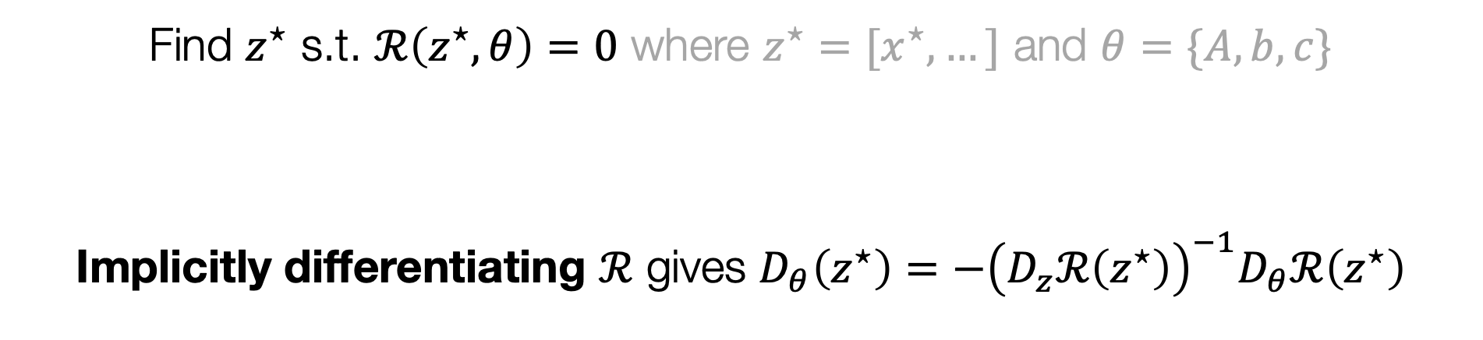
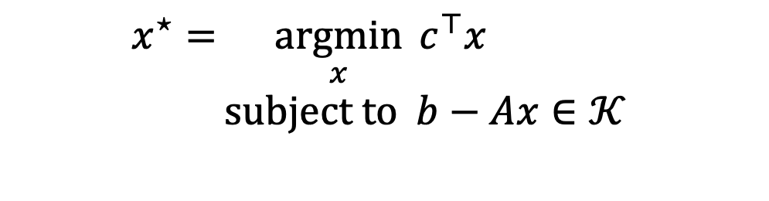
Implicitly differentiating a conic program
Section 7 of my thesis
$$x^{⋆}=\underset{x}{argmin}{c^{⊤}x} \\ subject to b−Ax∈𝒦$$
Conic Optimality
Find $z^{⋆}$ s.t. $ℛ\left(z^{⋆}, θ\right)=0$ where $z^{⋆}=[x^{⋆},…]$ and $θ=\{A,b,c\}$
Implicitly differentiating $ℛ$ gives $D_{θ}\left(z^{⋆}\right)=−{\left(D_{z}ℛ\left(z^{⋆}\right)\right)}^{−1}D_{θ}ℛ\left(z^{⋆}\right)$

Slide 17
Applications of differentiable convex optimization
Learning hard constraints (Sudoku from data)
Modeling projections (ReLU, sigmoid, softmax; differentiable top-k, and sorting)
Game theory (differentiable equilibrium finding)
RL and control (differentiable control-based policies, enforcing safety constraints)
Meta-learning (differentiable SVMs and optimizers, implicit MAML)
Energy-based learning and structured prediction (differentiable inference with, e.g., ICNNs)
Amortized optimization (as models or for enforcing constraints via differentiable projections)

Slide 18
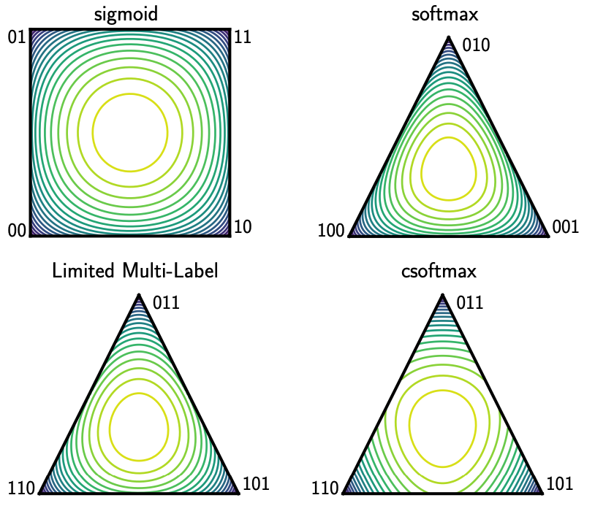
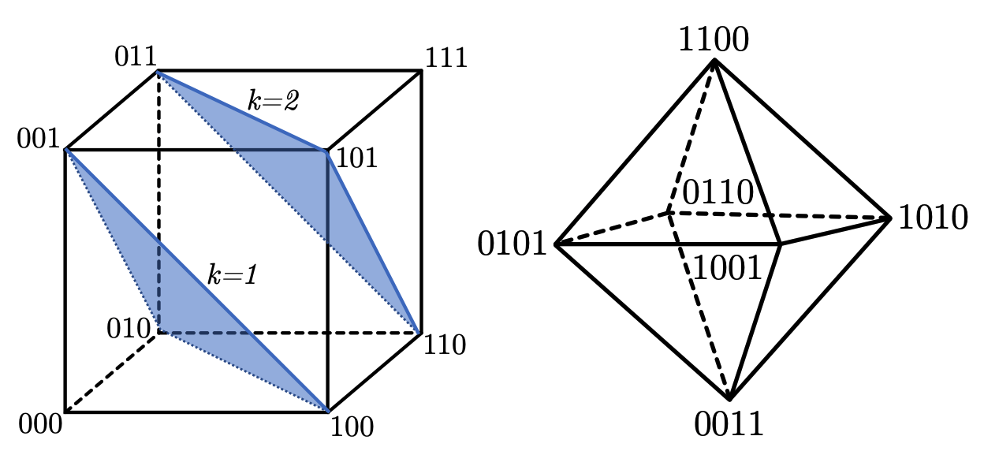
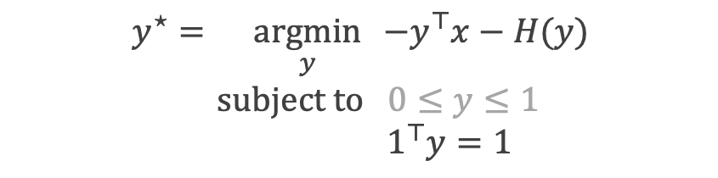
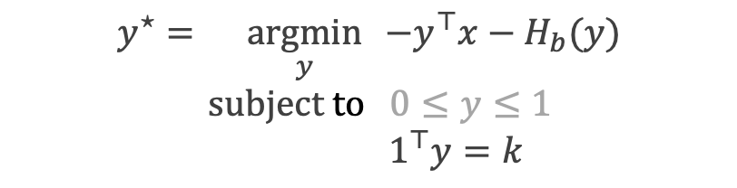
From the softmax to soft/differentiable top-k
Constrained softmax, constrained sparsemax, Limited Multi-Label Projection
$$y^{⋆}=\underset{y}{argmin}{ −y^{⊤}x−H(y)} \\ \text{subject} \text{to} 0≤y≤1$$
$$1^{⊤}y=1$$
$$y^{⋆}=\underset{y}{argmin}{ −y^{⊤}x−H_{b}(y)} \\ \text{subject} \text{to} 0≤y≤1$$
$$1^{⊤}y=k$$
Contours of the entropy penalties

Slide 19
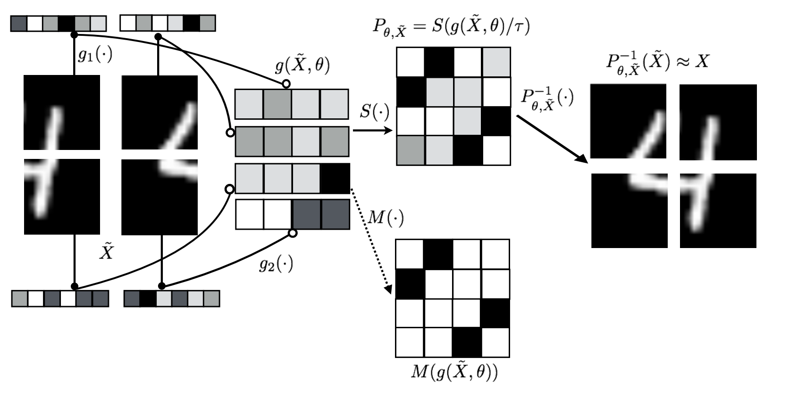
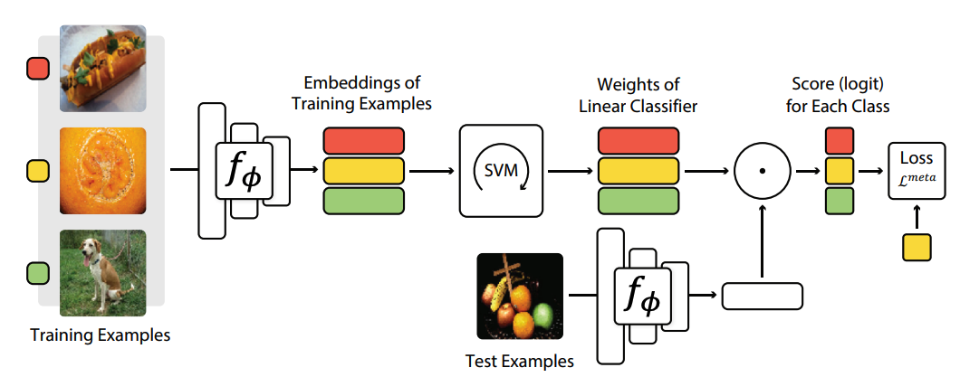

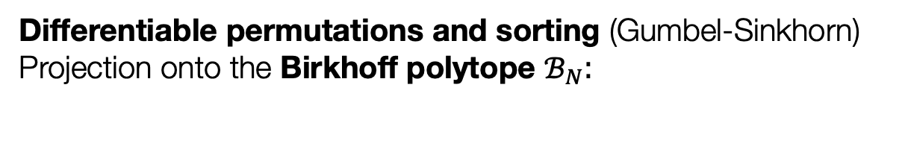
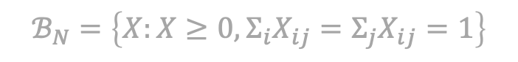
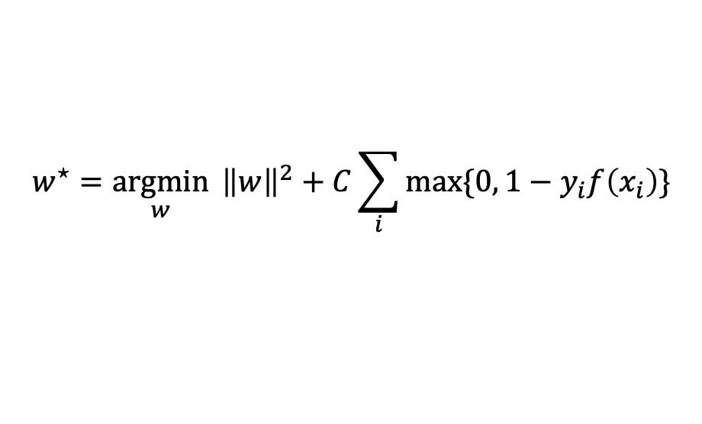
Differentiable permutations, sorting and SVMs
Differentiable permutations and sorting (Gumbel-Sinkhorn) Projection onto the Birkhoff polytope $ℬ_{N}$:
$$S\left(\frac{X}{τ}\right)=\underset{P∈ℬ_{N}}{argmax}{{ \left\langle P, X\right\rangle }_{F}+τH\left(P\right)}$$
$$ℬ_{N}=\left\{X:X≥0, Σ_{i}X_{ij}=Σ_{j}X_{ij}=1\right\}$$
Differentiable SVMs (MetaOptNet) Differentiate the decision boundary w.r.t. the dataset
$$w^{⋆}={\underset{w}{argmin}{ \left\|w\right\|}}^{2}+C\sum_{i}{\max{\{0, 1−y_{i}f\left(x_{i}\right)\}}}$$

Slide 20
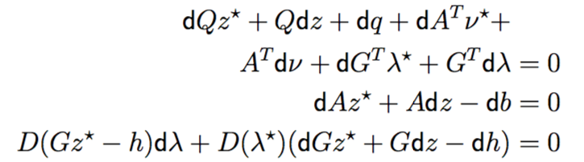
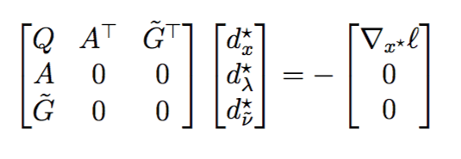
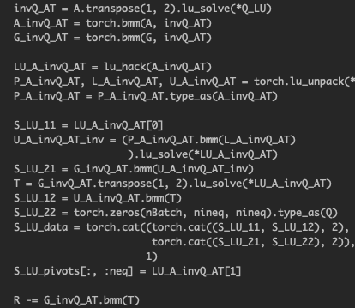
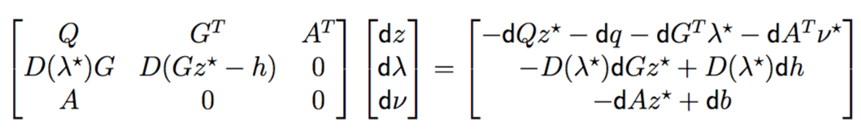
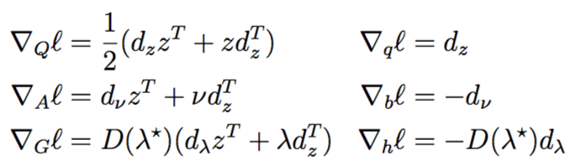
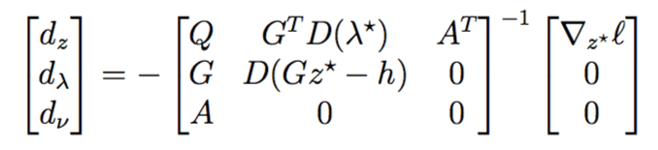
Optimization layers need to be carefully implemented

Slide 21
Why should practitioners care?

Slide 22
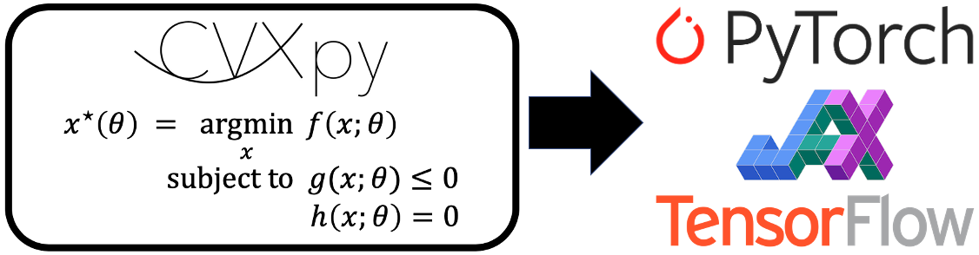

Differentiable convex optimization layers
NeurIPS 2019 and officially in CVXPY!
Joint work with A. Agrawal, S. Barratt, S. Boyd, S. Diamond, J. Z. Kolter
locuslab.github.io/2019-10-28-cvxpylayers

Slide 23
A new way of rapidly prototyping optimization layers

Slide 24
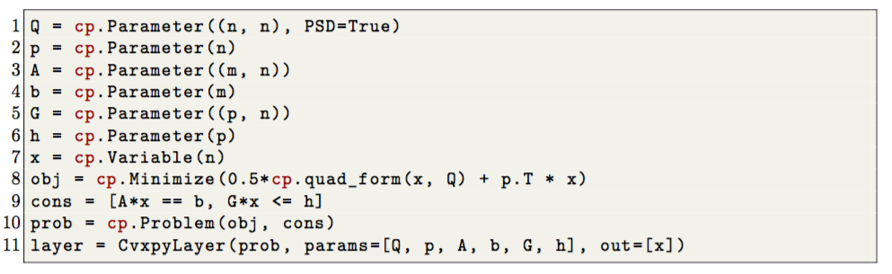
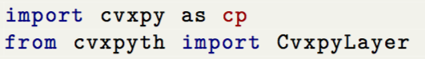
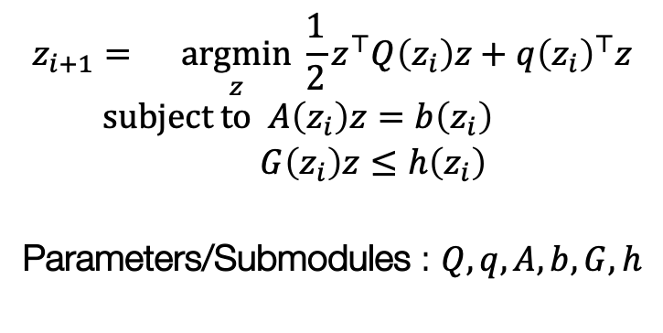
Code example: OptNet QP
Before: 1k lines of code
Now: 10 lines of code
$$z_{i+1}=\underset{z}{argmin}{\frac{1}{2}z^{⊤}Q\left(z_{i}\right)z+q{\left(z_{i}\right)}^{⊤}z} \\ subject to A\left(z_{i}\right)z=b\left(z_{i}\right) \\ G\left(z_{i}\right)z≤h\left(z_{i}\right)$$
Parameters/Submodules : $Q,q,A,b,G,h$

Slide 25
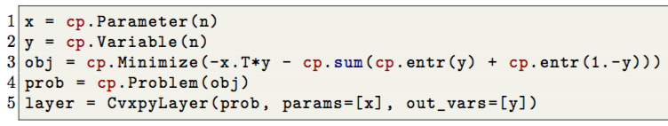
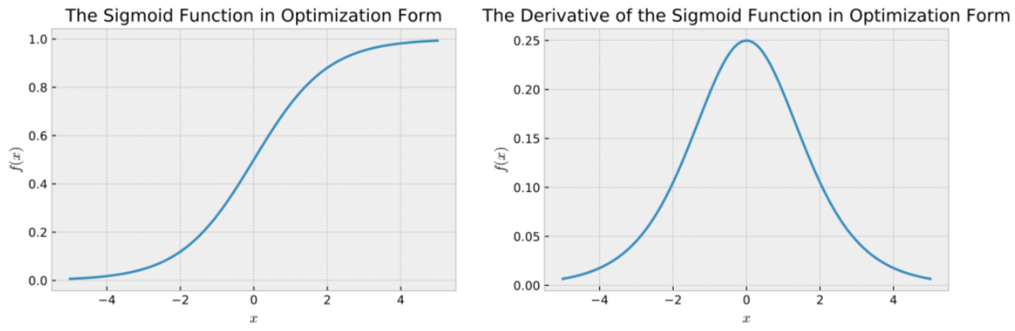
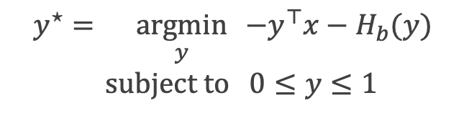
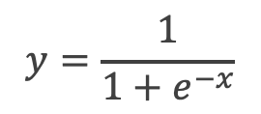
Code example: the sigmoid
$$y=\frac{1}{1+e^{−x}}$$
$$y^{⋆}=\underset{y}{argmin}{ −y^{⊤}x−H_{b}(y)} \\ \text{subject} \text{to} 0≤y≤1$$

Slide 26
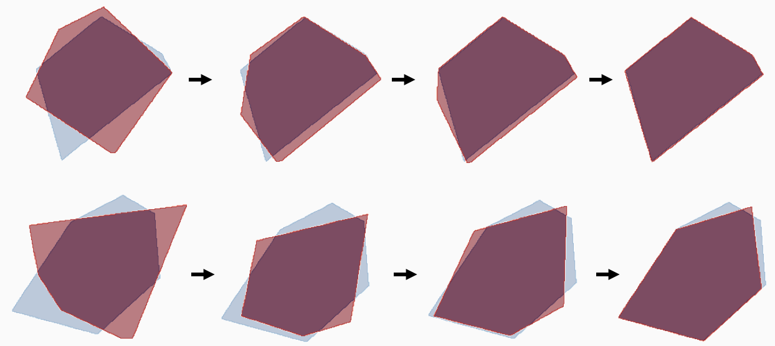





Code example: constraint modeling

Slide 27



Connections to sensitivity and perturbation analysis
Adjoint derivatives for optimization problems have been studied for decades
We have focused on uses for learning, but also widely used for sensitivity analysis
Logistic regression example
Find optimal decision boundary:
Use derivatives for sensitivity to the data points:
How much the data impacts the decision boundary
$$θ^{⋆}∈\underset{θ}{argmax}{\sum_{i}{\log{p_{θ}\left(y_{i} \right|{ x}_{i})}}}$$
$$\frac{∂θ^{⋆}}{∂x_{i}}$$

Slide 28


How do we handle non-convex optimization layers?
A lot of data
Model
Predictions
Loss
…
Optimization Layer
…
$$z_{i+1}=\underset{z}{argmin}{f_{θ}\left(z, z_{i}\right)} \\ subject to z∈C_{θ}\left(z, z_{i}\right)$$
If non-convex: 1. Implicitly differentiate the fixed-point of a non-convex solver - Form a locally convex approximation to the problem 2. Unroll gradient steps $∇_{z}f$ if unconstrained (MAML) 3. Unroll steps of another optimizer (differentiable cross-entropy method)

Slide 29
This talk: differentiable optimization-based models
Standard operations as convex optimization layers — warmup
Differentiable optimization theory and practice — core
Differentiable control and objective mismatch — focus application

Slide 30
Should RL policies have a system dynamics model or not?
Policy
Neural Network(s)
State
Action
System Dynamics
Future Plan
Model-free RL
More general, doesn’t make as many assumptions about the world
Rife with poor data efficiency and learning stability issues
Model-based RL (or control)
A useful prior on the world if it lies within your set of assumptions

Slide 31
Model Predictive Control
Known or learned from data

Slide 32

Why model predictive control?
Powerfully deployed in robotic systems, autonomous vehicles, aerospace settings, and beyond

Slide 33


Model Predictive Control
A pure planning problem given (potentially non-convex) cost and dynamics:
$$τ_{1:T}^{⋆}=\underset{τ_{1:T}}{argmin}{ \sum_{t}{C_{θ}(τ_{t})}} \\ \text{subject} \text{to} x_{1}=x_{\text{init}} \\ x_{t+1}=f_{θ}\left(τ_{t}\right) \\ \underline{u}≤u≤\overline{u}$$
Cost
Dynamics
where $τ_{t}=\{x_{t}, u_{t}\}$

Slide 34
Model Predictive Control with SQP
The standard way of solving MPC is to use sequential quadratic programming (SQP)
Form approximations to the cost and dynamics around the current iterate
Repeat until a fixed point is reached, then implicitly differentiate the fixed point

Slide 35
Challenge: complex systems are difficult to model
Modeling complex systems in the world is challenging
Often resort to data-driven approaches and learning to estimate unknown parts
$$τ_{1:T}^{⋆}=\underset{τ_{1:T}}{argmin}{ \sum_{t}{C_{θ}(τ_{t})}} \\ \text{subject} \text{to} x_{1}=x_{\text{init}} \\ x_{t+1}=f_{θ}\left(τ_{t}\right) \\ \underline{u}≤u≤\overline{u}$$
Cost
Dynamics
where $τ_{t}=\{x_{t}, u_{t}\}$

Slide 36


Standard model-based control training pipeline
Dynamics $f_{θ}$
Control
Policy $π_{θ}(x)$
Interacts
Environment
Training: Maximum Likelihood
Responses
Trajectories
State Transitions
Reward

Slide 37
Standard model-based control training pipeline
objective mismatch: dynamics unaware of reward
Similar to problems arising in predict then optimize settings
Dynamics $f_{θ}$
Control
Policy $π_{θ}(x)$
Interacts
Environment
Training: Maximum Likelihood
Objective Mismatch
Responses
Trajectories
State Transitions
Reward

Slide 38

Potential solutions to objective mismatch
1. Re-weight states to focus on high-value or high-advantage regions
2. This talk: use differentiable optimization to connect the dynamics and reward signal

Slide 39

Differentiable Model Predictive Control
A lot of data
Model
Predictions
Loss
…
Layer $z_{i}$
MPC Layer
…
What can we do with this?
Augment neural network policies in model-free algorithms with MPC policies Replace the unrolled controllers in other settings (hindsight plan, universal planning networks) Fight objective mismatch by end-to-end learning dynamics The cost can also be end-to-end learned! No longer need to hard-code in values

Slide 40

Differentiating LQR control is easy
Definition: Linear quadratic regulator
Riccati recursion solves the KKT system:
$$\min_{τ=\{x_{t}, u_{t}\}}{ \sum_{t}{τ_{t}^{T}C_{t}τ_{t}+c_{t}τ_{t} }}$$
$$\text{s}\text{.}\text{t}\text{. }x_{t+1}=F_{t}τ_{t}+f_{t} x_{0}=x_{\text{init}}$$
Backward pass: implicitly differentiate the LQR KKT conditions:
where
Just another LQR problem!

Slide 41

Differentiating LQR control is easy
Definition: Linear quadratic regulator
Riccati recursion solves the KKT system:
$$\min_{τ=\{x_{t}, u_{t}\}}{ \sum_{t}{τ_{t}^{T}C_{t}τ_{t}+c_{t}τ_{t} }}$$
$$\text{s}\text{.}\text{t}\text{. }x_{t+1}=F_{t}τ_{t}+f_{t} x_{0}=x_{\text{init}}$$
Backward pass: implicitly differentiate the LQR KKT conditions:
where
Just another LQR problem!

Slide 42

Objective Mismatch: Optimizing the task loss is often better than SysID in the unrealizable case
Best Imitation Loss
Approximate Model Class
True Model
Best MSE
True system: pendulum with noise (damping and a wind force) Approximate model: pendulum without the noise terms
~1.8x difference!

Slide 43
Another control optimizer: the cross-entropy method
CEM iteratively refining Gaussians
Iterative sampling-based optimizer that:
1. Samples from the domain 2. Observes the function’s values 3. Updates the sampling distribution Powerful optimizer for control and model-based RL

Slide 44
The Differentiable Cross-Entropy Method (DCEM)
CEM iteratively refining Gaussians
Differentiate backwards through the sequence of samples Using differentiable top-k (LML) and reparameterization
Useful when a fixed point is hard to find, or when unrolling gradient descent hits a local optimum
A differentiable controller in the RL setting

Slide 45


DCEM can learn the solution space structure
$$x^{⋆}=\underset{x∈{\left[0,1\right]}^{N}}{argmin}{f\left(x\right)}$$
Full Domain
Space of optimal solutions
Latent space of optimal solutions

Slide 46

DCEM fine-tunes highly non-convex controllers
sites.google.com/view/diff-cross-entropy-method

Slide 47
Closing thoughts and future directions
Differentiable optimization is a powerful primitive to use within larger systems
Theoretical and engineering foundations are here
Can be propagated through and learned, just like any layer
Provides a perspective to analyze existing models and layers
Applicable where optimization expresses non-trivial modeling operations including game theory, geometry, RL/control, meta-learning, energy-based learning, structured prediction
Extendable far beyond the (mostly convex) continuous Euclidean settings considered here

Slide 48


Differentiable optimization-based modeling for machine learning
Brandon Amos • Meta AI (FAIR)
Differentiable QPs: OptNet [ICML 2017]
Differentiable Stochastic Opt: Task-based Model Learning [NeurIPS 2017]
Differentiable MPC for End-to-end Planning and Control [NeurIPS 2018]
Differentiable Convex Optimization Layers [NeurIPS 2019]
Differentiable Optimization-Based Modeling for ML [Ph.D. Thesis 2019]
Differentiable Top-k and Multi-Label Projection [arXiv 2019]
Generalized Inner Loop Meta-Learning [arXiv 2019]
Objective Mismatch in Model-based Reinforcement Learning [L4DC 2020]
Differentiable Cross-Entropy Method [ICML 2020]
Differentiable Combinatorial Optimization: CombOptNet [ICML 2021]
Joint with Akshay Agrawal, Shane Barratt, Byron Boots, Stephen Boyd, Roberto Calandra, Steven Diamond, Priya Donti, Ivan Jimenez, Zico Kolter, Nathan Lambert, Jacob Sacks, Omry Yadan, and Denis Yarats

